Slide 1
CSE440 • ARTIFICIAL INTELLIGENCE
TEAM MEMBERS
AUTONOMOUS INDOOR NAVIGATION ROBOT
MD ASRAFUL HOSSAIN
2232845642
Using A* Search for Path Planning with Dynamic Obstacle Replanning
MD. SADMAN BIN MURTOZA
2232901642
SOFTWARE-ONLY SIMULATION
FAHIMA SHAMEEM
2131420642
Python • Tkinter • Occupancy Grid • A* • Virtual Robot
SANJIDA JAMAN
2212231042
PROJECT GROUP 6 | NORTH SOUTH UNIVERSITY
SECTION 2 • FACULTY: MSRB
PLAN → ACT → CHECK → ADAPT
GROUP 6 • MD ASRAFUL HOSSAIN • MD. SADMAN BIN MURTOZA • FAHIMA SHAMEEM • SANJIDA JAMAN
01

Slide 2
1 | The AI Problem
Indoor navigation is a goal-based intelligent-agent problem: the agent must plan, act, observe a changing grid, and revise its plan.
STATE
GOAL
ACTIONS
CHALLENGE
What the agent knows
What it must achieve
What it can do
Why planning is needed
Occupancy grid + current robot position Start and destination cells
Reach destination without entering blocked cells
Move ↑ ↓ ← → one cell at a time Unit movement cost
Obstacles may appear on the remaining route A valid old plan can become invalid
THE AGENT LOOP
1
REPRESENT
2
PLAN
3
ACT
4
CHECK
5
ADAPT
grid + robot state
A* chooses a promising route
move one safe cell
validate next cell
replan if blocked
AI connection: the system uses heuristic knowledge to guide search toward the goal, executes actions, and changes its plan when the environment changes.
GROUP 6 • MD ASRAFUL HOSSAIN • MD. SADMAN BIN MURTOZA • FAHIMA SHAMEEM • SANJIDA JAMAN
02

Slide 3
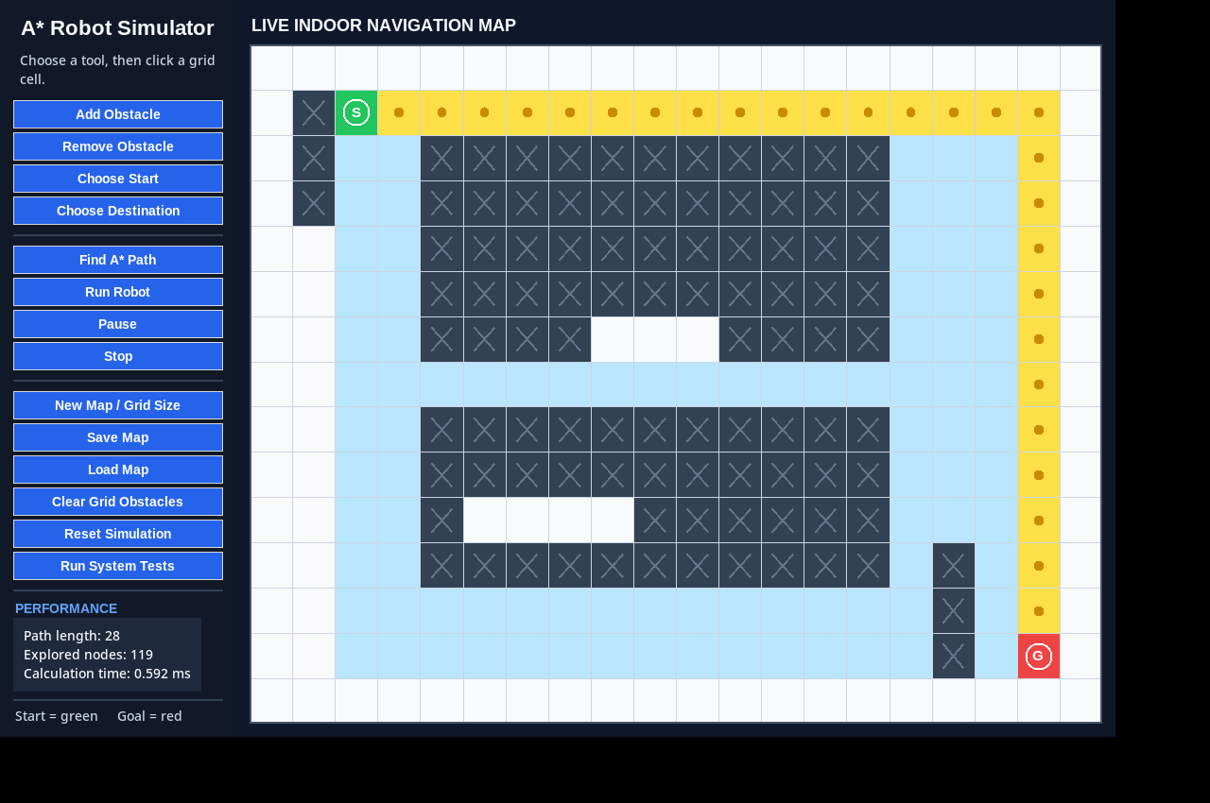
2 | Environment Representation
The indoor floor plan is discretized into an occupancy grid so that navigation becomes a graph-search problem.
OCCUPANCY GRID MODEL
0 = FREE CELL 1 = OBSTACLE
• Each cell is a navigable state in the search space.
• Start and destination are user-selected free cells.
• Obstacles can be added or removed while the simulation is running.
• The map module also validates and saves/loads grid layouts.
Movement model: 4-connected grid
GUI legend: green = start • red = goal • dark = obstacle • yellow = planned route
GROUP 6 • MD ASRAFUL HOSSAIN • MD. SADMAN BIN MURTOZA • FAHIMA SHAMEEM • SANJIDA JAMAN
03

Slide 4
3 | Why A*? — Informed Search
A* combines the cost already travelled with an estimate of the remaining cost, making search goal-directed rather than blind.
A* EVALUATION
MANHATTAN HEURISTIC
f(n) = g(n) + h(n)
h(n) = |x₁ − x₂| + |y₁ − y₂|
best estimated total path cost
• Matches the robot's movement restriction to up, down, left, and right.
• Each move has equal cost, so Manhattan distance never needs diagonal shortcuts.
• The heuristic guides A* toward states that are promising for the destination.
• The planner uses a priority queue to expand the lowest estimated-cost state first.
g(n)
h(n)
actual cost from start
estimated cost to goal
SEARCH BEHAVIOR
1
EXPAND
2
EVALUATE
3
RECONSTRUCT
4
VALIDATE
Choose the lowest f(n).
Check valid neighbors.
Trace the best path.
Confirm every step is safe.
GROUP 6 • MD ASRAFUL HOSSAIN • MD. SADMAN BIN MURTOZA • FAHIMA SHAMEEM • SANJIDA JAMAN
04

Slide 5
4 | System Architecture
Four focused modules separate data, planning, robot behaviour, and visualization; main.py integrates the complete application.
MEMBER 1
MEMBER 2
ENVIRONMENT
PLANNING
map_model.py
astar.py
Occupancy-grid creation • obstacle management • start/goal selection • map save/load
A* search • Manhattan heuristic • priority queue • path reconstruction • validation • replanning
MEMBER 3
MEMBER 4
ACTION / STATE
VISUALIZATION / TEST
virtual_robot.py
gui_graphics.py
Step-by-step movement • travelled/remaining path • pause/resume/stop • blocked-cell detection
Tkinter interface • rendering • controls • warnings • performance panel • system tests
main.py → GROUP-LEVEL INTEGRATION
Each member developed a core module; main.py connects the modules for the complete application.
GROUP 6 • MD ASRAFUL HOSSAIN • MD. SADMAN BIN MURTOZA • FAHIMA SHAMEEM • SANJIDA JAMAN
05

Slide 6
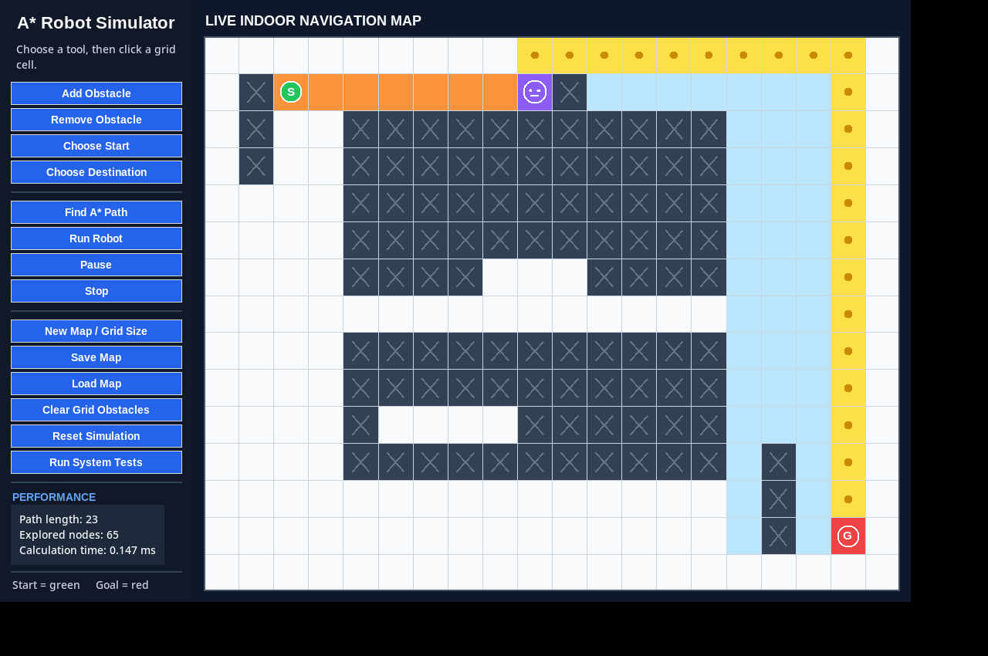
5 | From Plan to Safe Action
A computed path is not blindly trusted: the virtual robot re-checks the next cell immediately before movement.
SAFETY + REPLANNING LOGIC
1
FOLLOW
Robot moves along the current route.
2
DETECT
Next planned cell is checked before entry.
3
STOP
If blocked, robot remains at its last safe position.
4
REPLAN
A* starts again from the current position.
5
CONTINUE
New route is accepted only if valid.
Example: the route changes after a new obstacle blocks the remaining path.
Key safety idea: planning and movement validation are separate — a stale route cannot force entry into a newly blocked cell.
GROUP 6 • MD ASRAFUL HOSSAIN • MD. SADMAN BIN MURTOZA • FAHIMA SHAMEEM • SANJIDA JAMAN
06

Slide 7
6 | Team Contributions & Collaborative Integration
Each member owned a core module; integration, debugging, testing, and the final runnable system were completed collaboratively.
MD ASRAFUL HOSSAIN
MD. SADMAN BIN MURTOZA
BUILDING THE WORLD
FINDING THE BEST ROUTE
map_model.py
astar.py
Creates/resizes the occupancy grid; manages obstacles; protects start/destination cells; supports JSON map save/load and validation.
Implemented A* search, Manhattan heuristic, neighbor expansion, priority queue, path reconstruction and validation, explored-node tracking, performance reporting, and the replanning entry point.
FAHIMA SHAMEEM
SANJIDA JAMAN
MAKING THE ROBOT ACT SAFELY
MAKING THE AI VISIBLE
virtual_robot.py
gui_graphics.py
Manages robot state, step-by-step movement, travelled/remaining cells, pause/resume/stop/reset, blocked-next-cell detection, and acceptance of replanned paths.
Implemented Tkinter GUI, colour-coded grid/path/robot rendering, controls, warnings, performance dashboard, and in-application system tests.
GROUP-LEVEL INTEGRATION → main.py connects all modules into the final runnable system. All four members contributed to integration, debugging, and end-to-end testing.
GROUP 6 • MD ASRAFUL HOSSAIN • MD. SADMAN BIN MURTOZA • FAHIMA SHAMEEM • SANJIDA JAMAN
07

Slide 8
7 | GUI = Visualization + Evidence
The interface is not only a front end: it exposes the agent's internal decisions, state, safety checks, and measured performance.
WHAT THE USER CAN SEE
WORLD
Free cells, obstacles, start and destination
SEARCH
Explored cells + selected A* route
ROBOT
Current position + travelled route
CONTROL
Find path, run, pause, stop, reset, save/load
EVIDENCE
Path length, explored nodes, calculation time, system tests
The GUI turns an abstract search algorithm into observable agent behaviour.
GROUP 6 • MD ASRAFUL HOSSAIN • MD. SADMAN BIN MURTOZA • FAHIMA SHAMEEM • SANJIDA JAMAN
08

Slide 9
8 | Testing & Measured Performance
We verified correctness, failure handling, dynamic replanning, cross-module integration, and representative runtime.
FUNCTIONAL TEST COVERAGE
REPRESENTATIVE A* RUNTIME • 200 RUNS / GRID
✓
Reachable path
valid route returned
0.129
0.320
0.762
1.268
ms
ms
ms
ms
✓
Unreachable goal
safe failure reported
10 × 10
15 × 20
20 × 30
30 × 40
✓
Narrow passage
constrained route found
83
204
458
Obstacle safety
robot stops before blocked cell
10 × 10 explored
15 × 20 explored
20 × 30 explored
✓
✓
Integration
core modules work together
ALL CORE INTEGRATION TESTS PASSED
5 × 5 scenario: map → A* → robot → dynamic block → replan
Measurement note: these are representative software timings, not hardware-independent benchmarks.
GROUP 6 • MD ASRAFUL HOSSAIN • MD. SADMAN BIN MURTOZA • FAHIMA SHAMEEM • SANJIDA JAMAN
09

Slide 10
9 | Current Scope, Limitations & Future Work
The simulator demonstrates the planning problem clearly while making its boundaries explicit.
CURRENT SCOPE
WHAT IT DOES NOT YET DO
NEXT STEPS
• Software-only simulation; no physical robot or sensors.
• Two-dimensional occupancy-grid environment.
• Four-direction, uniform-cost movement.
• Dynamic obstacles are introduced by the user.
• Tkinter provides interactive visualization and controls.
• No sensor-based obstacle discovery.
• No localization uncertainty or physical stopping distance.
• No diagonal movement or weighted terrain costs.
• No continuous real-world replanning workload.
• No hardware performance claim.
• Connect sensors and physical robot control.
• Discover obstacles automatically in real time.
• Add 8-direction movement with an octile heuristic.
• Use weighted terrain and larger floor plans.
• Explore incremental replanning such as D* Lite.
• Support image/file-based floor-plan import.
The project is intentionally a controlled AI simulation: it isolates planning, decision-making, execution, and adaptation so each can be tested and explained.
GROUP 6 • MD ASRAFUL HOSSAIN • MD. SADMAN BIN MURTOZA • FAHIMA SHAMEEM • SANJIDA JAMAN
10

Slide 11
11 | End-to-End Workflow
How the four modules cooperate during one navigation run
1
MAP
2
PLAN
3
ACT
4
CHECK
5
ADAPT
Load/create occupancy grid
A* + Manhattan heuristic
Move one safe cell at a time
Verify the next cell
Replan from current position if blocked
map_model.py
astar.py
virtual_robot.py
virtual_robot.py
All modules
ORIGINAL ROUTE
A* path is computed
OBSTACLE APPEARS
A route cell becomes blocked
SAFE STOP
Robot pauses before entry
NEW ROUTE
A* replans from current cell
→
→
→
Key AI behaviour: when the environment changes, the agent validates the next move and replans instead of following a stale route.
GROUP 6 • MD ASRAFUL HOSSAIN • MD. SADMAN BIN MURTOZA • FAHIMA SHAMEEM • SANJIDA JAMAN
11

Slide 12
12 | Final Takeaway
One integrated intelligent agent: represent the world → plan intelligently → act safely → adapt to change.
REPRESENT
PLAN
ACT
VISUALIZE + TEST
map_model.py
astar.py
virtual_robot.py
gui_graphics.py
Asraful
Sadman
Fahima
Sanjida
WHAT WE DEMONSTRATED
A* finds a shortest safe path on the represented grid. The virtual robot executes it safely, checks the next cell before movement, and triggers replanning when a newly introduced obstacle blocks the remaining route.
NEXT → 1-MINUTE VIDEO DEMO • 4-MINUTE GITHUB / CODE WALKTHROUGH • Q&A
Thank you • Questions?
GROUP 6 • MD ASRAFUL HOSSAIN • MD. SADMAN BIN MURTOZA • FAHIMA SHAMEEM • SANJIDA JAMAN
12

Slide 13
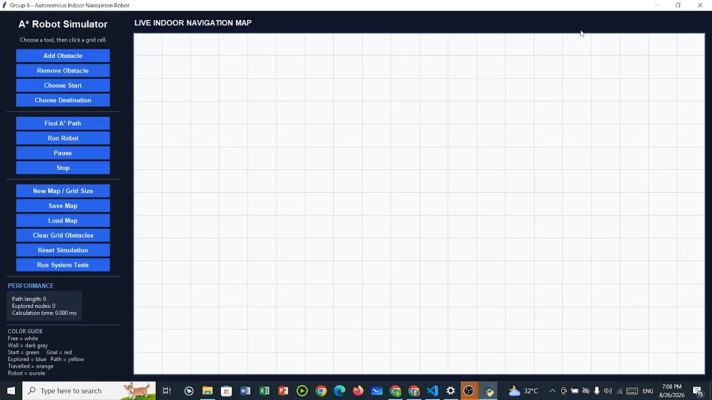
13 | 1-Minute Video Demo
Autonomous Indoor Navigation — A* path planning with dynamic obstacle replanning
DEMO HIGHLIGHTS
• A* path planning on an occupancy grid
• Virtual robot follows the computed route
• Obstacle insertion during execution
• Automatic replanning to a safe alternative path
• Live GUI visualization and performance feedback
PROJECT DEMONSTRATION • 1:00
GROUP 6 • MD ASRAFUL HOSSAIN • MD. SADMAN BIN MURTOZA • FAHIMA SHAMEEM • SANJIDA JAMAN
13

